Slide 1
Employee Data Analysis using Excel
STUDENT NAME: MD.SREEMATHI
REGISTER NO: 312200203
DEPARTMENT:COMMERCE ( Bcom general )
COLLEGE. SIVET COLLEGE

Slide 2
PROJECT TITLE
Employee Performance Analysis using Excel

Slide 3


AGENDA
Problem Statement
Project Overview
End Users
Our Solution and Proposition
Dataset Description
Modelling Approach
Results and Discussion
Conclusion
3/21/2024 Annual Review

Slide 4

PROBLEM STATEMENT
Employee performance analysis:
It means how well the employee doing his job , or if any training should be given to get better results , if he is doing his best performance to give incentive

Slide 5

PROJECT OVERVIEW
Performance analysis
Performance analysis focuses on evaluating an employee's work over a brief Period. This type of analysis is particularly useful for monitoring progress identifying immediate issues

Slide 6
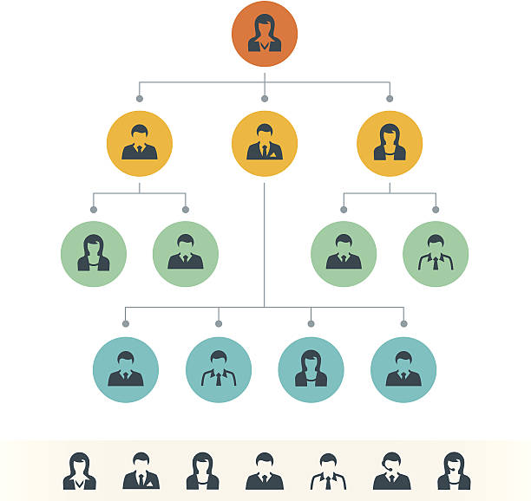
End users

Slide 7

OUR SOLUTION AND ITS VALUE PROPOSITION
• Conditional formatting- Missing
• Filter- remove
• Formula- performance
•Pivot- sumary
• Graph- data visualization

Slide 8
Dataset Description
A dataset description provides a concise overview of dataset's key aspects:
Name, source, purpose, time period, structure, variables, data quality, usage, contact.
This summary highlights the essential details for quick understanding

Slide 9
MODELLING
A modlling approach in performance analysis involves systematically creating, validating and using models to understand and improve the performance of a system.
1. Define objectives and scope
2. System understanding
3. Choose the modelling techniques
4. Model development
5. Performance analysis and experimentation
10

Slide 10
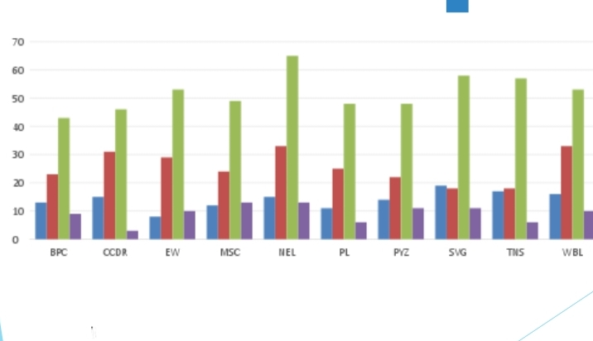
RESULTS
11

Slide 11
conclusion
From this analysing we come know about the employee performance by using excel
We also created pivot table for visualising and easy to understand

